Slide 1
FIS DigiCaaS
(Digital Cheque over Blockchain)
InnovateOn 2021 Run Off

Slide 2
CodeChefs – Out of the Cubicle, Into the Fire
Idea Owner and Presenter
Vivek Tandon
Gateway Architect
Satish Kumar Pavurayala
Software Engineer Specialist
Srihari Metikala
IT Architect
Rakesh Bhat
Software Engineer Senior
Aditya Kaushik
Software Engineer
“Innovation is seeing what everybody has seen and thinking what nobody has thought.”

Slide 3
Problem Statement
Paper Cheque in a Digital World
As per the RBI’s monthly bulletin, the banking system reported 6.43 crore paper-based transactions on the CTS worth Rs 5,241 crore in October 2020
Cheque clearing time varies from 2 days to 5 days with lot of manual efforts.
Check fraud, or the attempt to perpetrate it, has gone up from $8.5 billion in 2016 to $15.1 billion in 2018. Also, it makes up 60 percent of all attempted fraud against U.S. bank deposit accounts, according to a survey released by the American Bankers Association.
Checks are easier to commit fraud with because they have a lot of information on them, they can be forged or even stolen. They’re still the most popular form of payments between businesses, according to a survey of treasury and finance professionals by the Association for Finance Professionals.

Slide 4
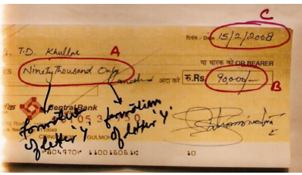
Types of Cheque Fraud
Counterfeit Cheque: In this type of fraud a cheque is created on non-bank paper. The cheque looks genuine but is fake. However, the cheque related to a genuine account. Fraudster creates such cheques to fool the bank and steal money from a genuine bank account.
Forgery: This is one of the most cheque frauds. In such a fraud attempt, scammers use genuine cheques and forge account holder's signature to fool the bank. If the signatures are close to perfect, banks can be fooled, and fraudsters are able to steal money from unsuspecting victims.
Fraudulently altered cheques: In such fraud cases, the cheque and account holder's signature is genuine, but the fraudster alters the original check before encashing it. In a majority of such frauds, recipient's name or the amount is altered after the cheque is signed by the account holder.

Slide 5
Solution
FIS DigiCaas
Digital Cheque as a Service
(Using Blockchain)

Slide 6





Technologies Used

Slide 7
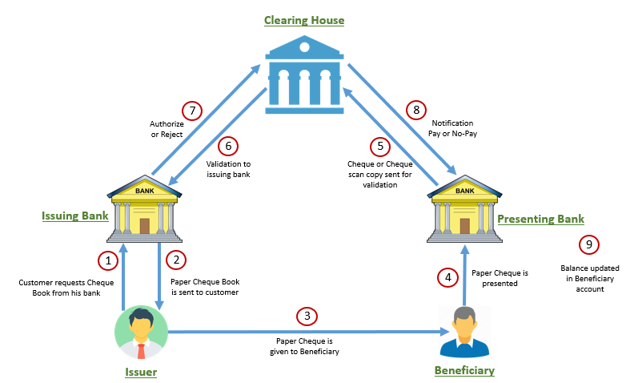
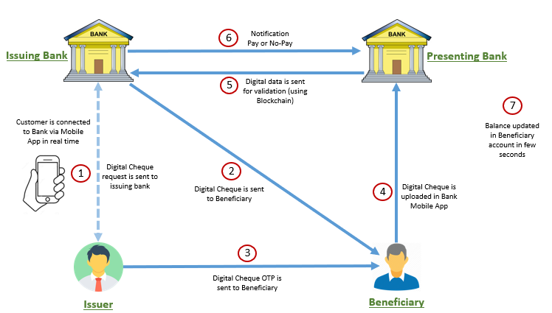
Architecture
Current Architecture Vs. Proposed Architecture

Slide 8
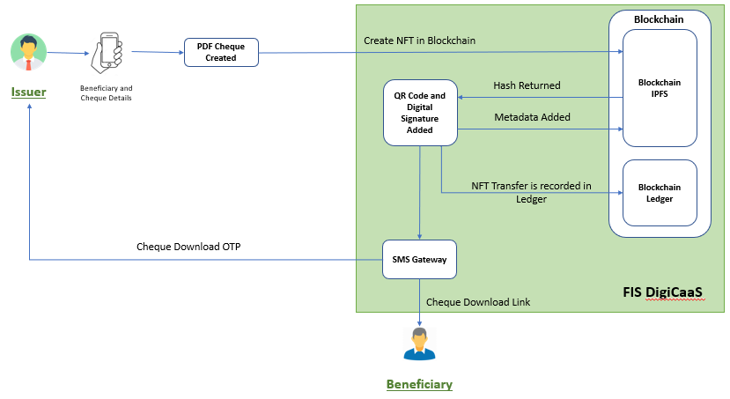
Issuing Digital Cheque

Slide 9
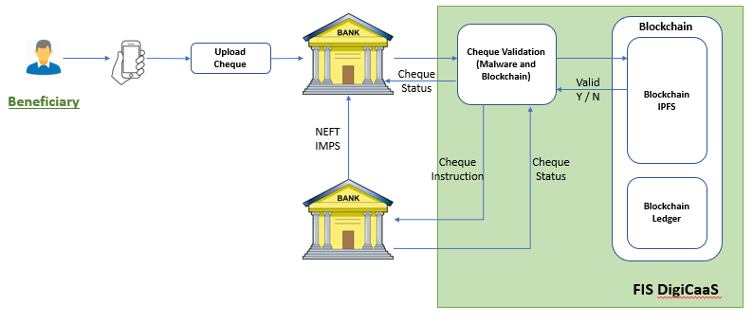
Presenting Digital Cheque

Slide 10
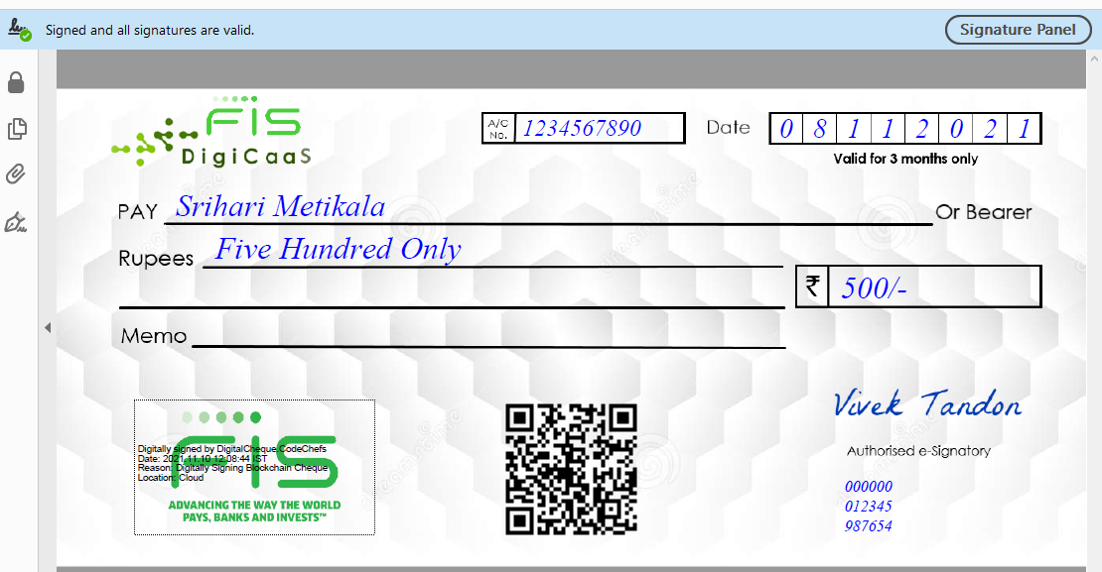
A Sample Digital Cheque
Verified Digital Signature
PIN: 9549
Digital Signature
QR Code Generated with IPFS Hash
Customer’s
e-Signature

Slide 11
WOW Factors
No need to carry a cheque book. Issue a cheque from your mobile app as and when required, 24/7.
Alert to the customer in case of his account balance going below the total amount of issued cheque/cheques. This will help the issuer to avoid any unwanted cheque bounce impaction his credit history and bank fine.
The customer can cancel the issued digital cheque if required anytime from your mobile app, 24/7. A notification will be sent to the beneficiary about cheque cancellation, so he doesn’t present the cheque in his bank.
Ultimate security with blockchain and data already available as digital asset about the issued cheque.
Cheque processing and amount crediting are completed within seconds.
Saving paper (important for our mother earth).
The benefit of not sharing bank details with other parties as needed in the NEFT transaction. The beneficiary can deposit the cheque in any of his bank account.
No more need of making a new paper cheque book request, it typically takes at least five business days before you receive it.

Slide 12
DEMO

Slide 13
Q & A

